Slide 1



ADMS Phase 2 - FocalPoint Replacement Options Analysis and Recommendations Svetlana Lyba – Domain Architect Hong Chen – Business Analyst Goutam Ghatak – Lead Solution Architect Nishit Ajwaliya- Information Architect Mahantesh Vantmuri – Solution Architect Del Sian – Data Peter S. – Security Architect
Classification: Internal / Confidential
Date: June 2021
Version: v1.0
Working deck - DRAFT

Slide 2


Agenda
Objective
Description
Executive Summary
Details here
1
2
Current State
Future Needs
Details here
3
Replacement Options
Recommendations
Details here
4

Slide 3

1
Executive Summary

Slide 4
FocalPoint Replacement – Solution Selection Approach
Information Gathering
Options Review
Recommendation
March 2021
April
May
June 2021
Options Identification
Refinement & Analysis
PROBLEM
APPROACH
RECOMMENDATION
Focal Point Technical Debt
Add Details
Elicited, Refined and Prioritized Business and Technical Requirements
Defined Key Business Issues
Conducted a current state assessment on FocalPOint
Engaged ABB and internal teams to assess viable options
Business requirements and use cases refined
Assessed ability to support business outcomes and required capabilities
Assessed implementation options and TCO
Add details ..
TBD

Slide 5
Executive Summary
Option 1
ABB Power BI
Option 2
ABB Next Gen
Option 3
NG Power BI/
Snowflake
Summary
Approach
Impact
Summary
Approach
Impact
Summary
Approach
Impact
Recommendation

Slide 6
Next Steps
Details TBD
Details TBD
Details TBD

Slide 7
2
Current State

Slide 8
FocalPoint- Current State
Key Existing Capabilities
Online Reporting reports for NY and NE Control Rooms, Regulatory, and Customer Contact Centers, and Outage Management
Generic Reporting Capabilities
Automated Reports
Automated File Transfer
Integration with 3rd parties
Access for 3000+ authorized users across the organization
Pain Points
Outdated Software and Infrastructure
The current version of FocalPoint is deprecated.
Web reports are only available via Internet Explorer web browser, which is end of life
No mobile app capabilities
Add Details
New Needs
Separate reporting of data from core OMS functions to minimize performance impact
Provide capability for read-only users to get outage information outside of OMS access
Mobile Enablement
Add details

Slide 9
Focal Point – Current Usage Summary
Reports (97)
Control Room Reports
Critical Customer/Life Support Reports
Regulatory Reports
Storm Reports
OMS Reports
System Message
Web Applications (3)
OMS Web Call Entry
OMS Support
Crew Sheets
Windows Service Application (about 20)
Automated Reports and Notifications
Interfaces
Monitor
Purge Data
Criticality
Very High
High
Medium
Low
Very Low
User
Control Rooms
Regulatory
Customer Contact Centers
OMS / OMS Support
Frequency
On demand
Scheduled for automated reports and notifications (daily, hourly, 15 min, 5 min, etc.)

Slide 10
Focal Point – Existing Data Entity View
Customer
Residential and Critical
Life support Facilities
Outage
Cause Category
Hazard Level Type
Trouble
JTK Event,
Source
Workforce
Employee,
Contractor
Crew,
Admin Operator
Worker Activity
Employee/Contractor Activity
Crew Activity
Asset
Line
Meter
Devices
Feeder
Node
Load
Substation
Equipment Category
Earliest Time Response (ETR) Audit
Customer Call
Calls
Referral
Earliest Time Response
Data Classification -

Slide 11
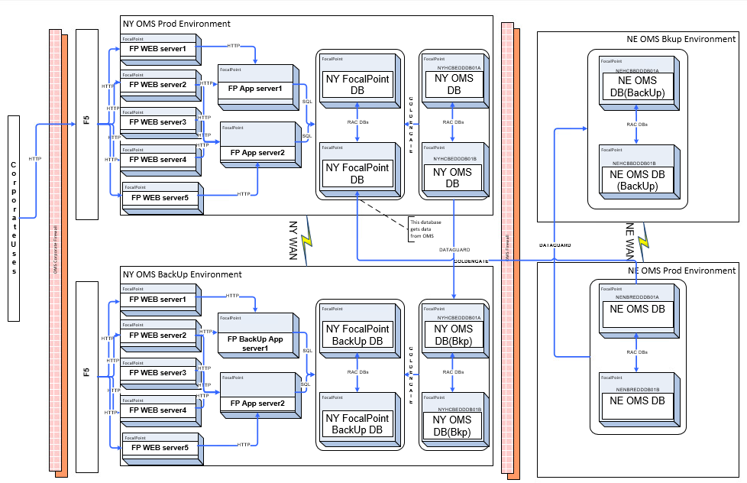
Current Technology/Architecture Highlights
Separate NY/NE databases
Data is refreshed from OMS in near real time
All components are within CNI data center
Outdated Software and Infrastructure
The current version of FocalPoint is deprecated

Slide 12
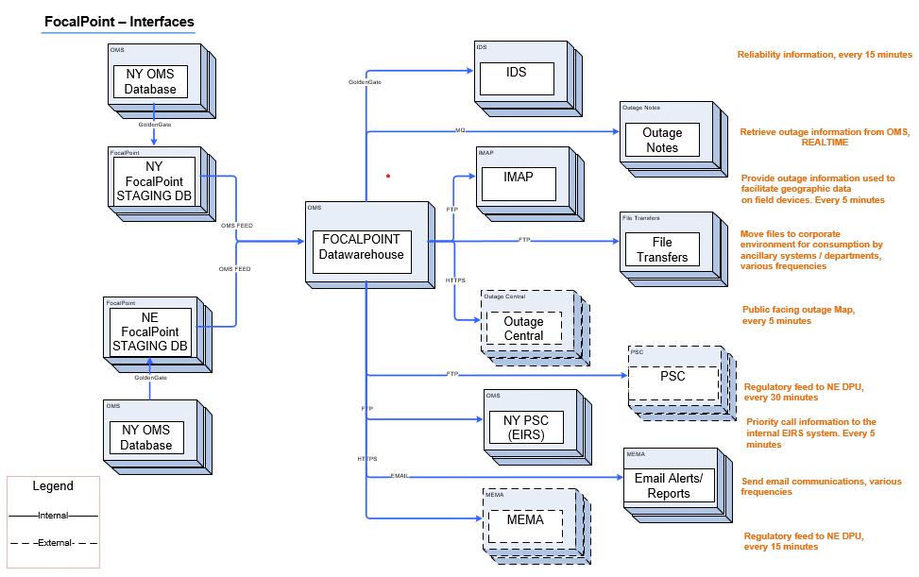
FocalPoint - Interfaces
Add Highlights - existing inefficiencies, opportunity to optimize

Slide 13
Migration Needs
Reports
Add Details (summary)
Data Replication
Add Details(summary)
Integrations
Add details (summary)
Non-Func Reqs Highlight
DR
Availability
Data Classification…
Security

Slide 14
UseCases /Scenarios Summary

Slide 15

3
Focal Point Replacement Options

Slide 16
Assessment Framework
Selection Criteria
Business/Functional Capabilities
Technical Capabilities
Maturity & Stability of Platform
Security Compliance
Solution Risks
Implementation Options
Impact to in-flight Programs
Resource/Skills Dependency
Support Model
ROM Cost Comparison
Time To Market
Benefits Summary
Data as an Asset support
Digital Enablement
Strategic Direction/Roadmap
Market Adoption
IT Architecture Principles support

Slide 17
Objectives and Strategies incorporated into Assessment
Access
New and /or improved ways of engaging and enabling the employees and customer
Hosting Objectives
Implementation Strategy
Agile ways of delivery by adopting a PRODUCT mindset, self contained teams, and agile delivery mechanisms
Digital Strategy
Use of digital technologies
Enabling the digital Employees tools that allow workers to do frictionless
Rich data content for our users to be enabled to do work, all seamless on device of choice and connected
Agile ways of delivery
CNI vs Non-CNI Hosting….. If no requirements to host in CNI, look for alternatve hosting options to enable access from corporate.
Movement to separate localized Data Centers by leadership per strategic objectives

Slide 18
3a - ABB Power BI Offering

Slide 19
Option 1 - ABB Power BI Offering
Description
Business Capabilities Support
Out of the Box Capabilities-%
Development Needs %
Maturity & Stability of Platform
ABB Power BI Offering is available since XXXX
Utility Market Adoption
add details shared by ABB
Additional Key Highlights
Strategic Roadmap
7.2 OMS schema does not match Power BI requirements (needs 9.1 version). ABB provides Database, ETLs, reporting layer.
ABB creates commonly used dashboards (based on existing clients) and makes those available. ABB can meet some needs with canned dashboards. ~55% of existing FP dashboard functionality can be met with canned Power BI dashboards.
MS Power BI license is provided by NG. Product is GA now. Rolling out the software with baseline dashboards connected to 9.1.
According to ABB Power BI will be supported for at least next 5 - 10 years...
Will have maintenance support and limited enhancements
Product is GA now
Estimated that ABB needs to build around 25 custom reports for NGRID.
Migration Capabilities
For Power BI there is no porting tool.
Scripts exist to move current DB to SQL server for Power BI reporting
What about the rest ?

Slide 20
Option 1 - ABB Power BI Offering
Technology & Architecture
Technical Capabilities Support
Proposed Conceptual Solution
Hosting options
Data as an Asset
Security Compliance
ABB provides Database, ETLs, reporting layer.
Add details
By default, hosting is on prem for Power BI. No issue with using Azure for deployment. Power BI uses MicroSoft stack. Could capitalize on schema migration capabilities and vizualization
add details
Information is an asset which is fundamental to the efficient and effective delivery of IT services
IT Architecture Principles support
User Authentication, Roles and privileges, integration with AD, SSO capabilities ( verbal conformation from ABB)
Current tooling expects use of SSIS, SSAS, Power BI reporting server. Oracle -> SSIS -> DB in MDS -> SSAS -> Power BI .
All modern browsers supported for visualization
Mobile capable. All out-of-the-box Power BI capability; can be gotten from app store; standard MS capabilities.
Power BI settings/configurations allow access to be determined based on NG restrictions (RE: MS documentation).
NOTE - mobile users are view only
MS Stack
Projects will be justified with business cases including total cost of ownership and business benefits.
IT will build for today’s needs as well as innovate for the future.
End user experience will be at the forefront of IT designs
Leverage Out of Box Over Proprietary Solutions
Re-Use existing platforms before Buying new or Building unless a strategic advantage can be gained
Use open standards over proprietary solutions
Be conscious of vendor lock-in
Leverage cloud technologies where possible versus on premise data centers
Design for operations keeping security, scalability and disaster recovery at front of mind
Conceptual View and Integrations

Slide 21
Option 1 - ABB Power BI Offering
Implementation Considerations & Impact
Implement FP Replacement Prior to ADMS Phase 2A go Live
Implement FP Replacement together/as part of ADMS Phase 2A go Live
Implement FP Replacement after ADMS Phase 2A go Live 2A go Live
Pros: Details
Cons: 7.2 OMS schema does not match Power BI requirements (needs 9.1 version).
Pros: Details
Cons: Details
Pros: Details
Cons: Details

Slide 22
Option 1 - ABB Power BI Offering
Cost & Time to Market
Digital Enablement
Solution Risks
Impact to in-flight Programs
Resource/Skills Dependency
Support Model
ROM Cost Comparison
Time To Market
Benefits Summary
ABB hasn't done piece meal deployment due to complexities and risks introduced (e.g. performance and multi-product interactions).
ADMS Phase 2A implementation
ABB Resources Required
According to ABB Power BI will be supported for at least next 5 - 10 years...
Will have maintenance support and limited enhancements

Slide 23
3b – Option 2-
ABB Next Gen Offering

Slide 24
Option 2 - ABB Next Gen Offering
Business Capabilities Support
Out of the Box Capabilities-%
Development Needs %
Maturity & Stability of Platform
Add details
Utility Market Adoption
add details shared by ABB
Additional Key Highlights
Strategic Roadmap
Add details ( input from ABB)
Description

Slide 25
Option 2 - ABB Next Gen Offering
Technical Capabilities Support
Proposed Conceptual Solution
Hosting options
Data as an Asset
Security Compliance
Add details
Add details
Add details
add details
add details
IT Architecture Principles support
Add details
Technology & Architecture
Conceptual View

Slide 26
Option 2 - ABB Next Gen Offering
Implementation Considerations & Impact
Implement FP Replacement Prior to ADMS Phase 2A go Live
Implement FP Replacement together/as part of ADMS Phase 2A go Live
Implement FP Replacement after ADMS Phase 2A go Live 2A go Live
Pros: Details
Cons: Details
Pros: Details
Cons: Details
Pros: Details
Cons: Details

Slide 27
Option 2 - ABB Next Gen Offering
Cost & Time to Market
Digital Enablement
Solution Risks
Impact to in-flight Programs
Resource/Skills Dependency
Support Model
ROM Cost
Time To Market
Benefits Summary

Slide 28
3c – Option 3-
NG PowerBI/
Snowflake Solution

Slide 29
Option 3 - NG PowerBI/Snowflake Solution Snowflake Solution
Business Capabilities Support
Out of the Box Capabilities-Reports 0%
Development Needs Reports -100%
Maturity & Stability of Platform
Add details
Utility Market Adoption
add details
Additional Key Highlights
Strategic Roadmap
Add details
Description

Slide 30
Option 2 - NG PowerBI/Snowflake Solution
Technology & Architecture
Technical Capabilities Support
Proposed Conceptual Solution
Hosting options
Data as an Asset
Security Compliance
Add details
Add details
Add details
add details
IT Architecture Principles support
Add details
Projects will be justified with business cases including total cost of ownership and business benefits.
IT will build for today’s needs as well as innovate for the future.
End user experience will be at the forefront of IT designs
Leverage Out of Box Over Proprietary Solutions
Re-Use existing platforms before Buying new or Building unless a strategic advantage can be gained
Use open standards over proprietary solutions
Be conscious of vendor lock-in
Leverage cloud technologies where possible versus on premise data centers
Design for operations keeping security, scalability and disaster recovery at front of mind
Conceptual View

Slide 31
Option 2 - NG PowerBI/Snowflake Solution
Implementation Considerations & Impact
Implement FP Replacement Prior to ADMS Phase 2A go Live
Implement FP Replacement together/as part of ADMS Phase 2A go Live
Implement FP Replacement after ADMS Phase 2A go Live 2A go Live
Pros: Details
Cons: Details
Pros: Details
Cons: Details
Pros: Details
Cons: Details

Slide 32
Option 2 - NG PowerBI/Snowflake Solution
Cost & Time to Market
Digital Enablement
Solution Risks
Impact to in-flight Programs
Resource/Skills Dependency
Support Model
ROM Cost
Time To Market
Benefits Summary

Slide 33
Options- Comparison Summary
 | Option 1 ABB Power BI | Option 2 ABB Next Gen | NG Power BI/ Snowflake Solution
Business Capabilities ( Out of the box)
Business Capabilities ( Need Development)
Technical Capabilities
Data as an Asset support
Maturity & Stability of Platform
Market Adoption
Strategic Direction/Roadmap
IT Architecture Principles support
Digital Enablement
Security Compliance
Solution Risks
Implementation Options
Impact to in-flight Programs
Resource/Skills Dependency
Support Model
ROM Cost Comparison
Time To Market
illustrative, RAG TBD

Slide 34

4
Recommendations

Slide 35
Recommendations
TBD

Slide 36
5
Appendix

Slide 37
Focal Point – Reporting/Data View
Contact Attempts
Life Support
Life Support Admin
Crew Assignments
Crew Dispatch Lag
Crews Not Assigned
DNR Report
Data Error
ETR Batch Updates
ETR Final
ETR Missing
ETR Not Updated
Inaccurate Restore Time
Outages Over 8 Hrs
Peak Outage Summary
Regional Summary
Stray Voltage
DPU Outage Summary
Executive Outage Summary
Municipal Storm Summary
Unsuccessful 1&2
Unsuccessful 3 or more
Critical Facility PSC Report
PSC LSE Report
Critical Customer
Critical Customer Admin
Crew Assignments
Crew Dispatch Lag
Crews Not Assigned
DNR Report
ETR Batch Updates
ETR Final
ETR Missing
ETR Not Updated
Inaccurate Restore Time
Outages Over 8 Hrs
Peak Outage Summary
Regional Summary
Stray Voltage
Executive Outage Summary
Municipal Storm Summary
Customers Out By Locality
Customers Out By Locality / Feeder
Customers Out By Feeder
Feeder Lockout
General Outage Information
Management Outage Summary
Outage Report by Device
Single Customer Outages
Critical Customers
Life Support Customers
All Wires Down
Priority / 911 Calls
Priority / 911 Wires Down Calls
ETR Aging
Outages By Town
OMS Report
Restoration Crew Supervisor
ETR Metrics
Customers Out By Locality
Customers Out By Locality / Feeder
Customers Out By Feeder
Feeder Lockout
General Outage Information
Management Outage Summary
Outage Report by Device
PSC Report
PSC by County
PSC by Region
PSC by Town
Single Customer Outages
Life Support Customers
All Wires Down
Priority / 911 Calls
Priority / 911 Wires Down Calls
ETR Aging
Outages By Town
Current Outages
OMS Report
Restoration Crew Supervisor
ETR Metrics
Search - Calls
Search - Outages
System Messages
ETR Optimazation
Peak Outage Summary By Barn
Peak Outage Summary By Town

Slide 38
Focal Point – Reporting - Data Entity View
Customer
Admin Operators
Cause Category
Crew
Crew Activity
Critical Facilities
Device
Employee
Equipment Category
ETR Audit
Feeder
Hazard Level Type
JTK Event
Line
Load
Outage
Referral
Source
Substation
Trouble
Node
Call

